Slide 1
How to use ADVA
A step-by-step guide by The Sustainability Learning Lab

Slide 2
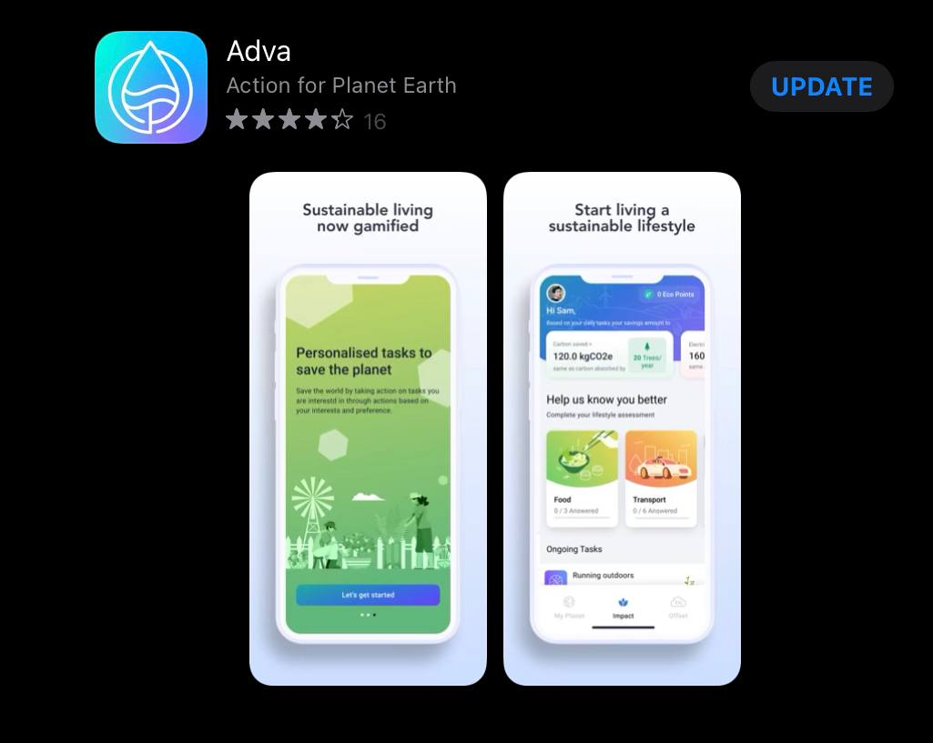
Download Adva
Available for IOS and Android

Slide 3
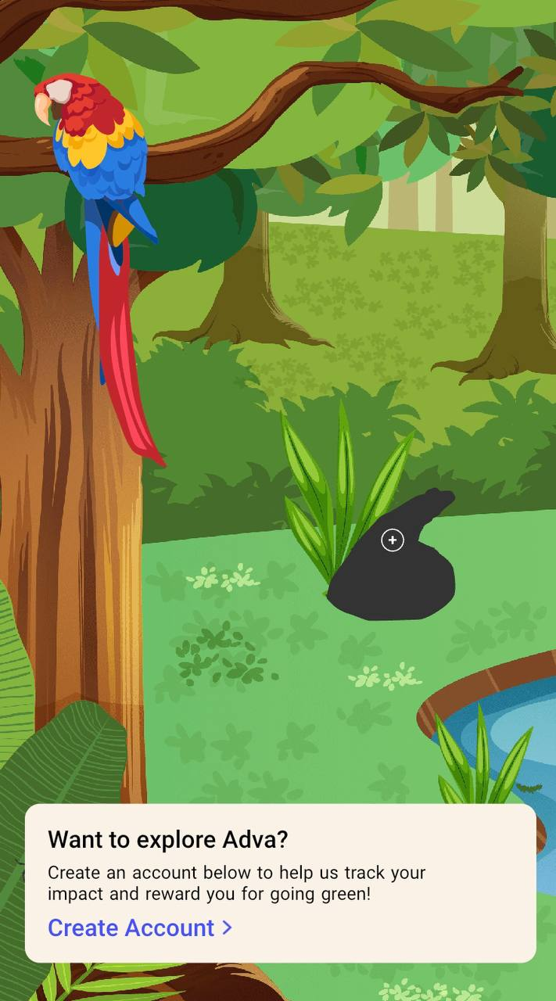
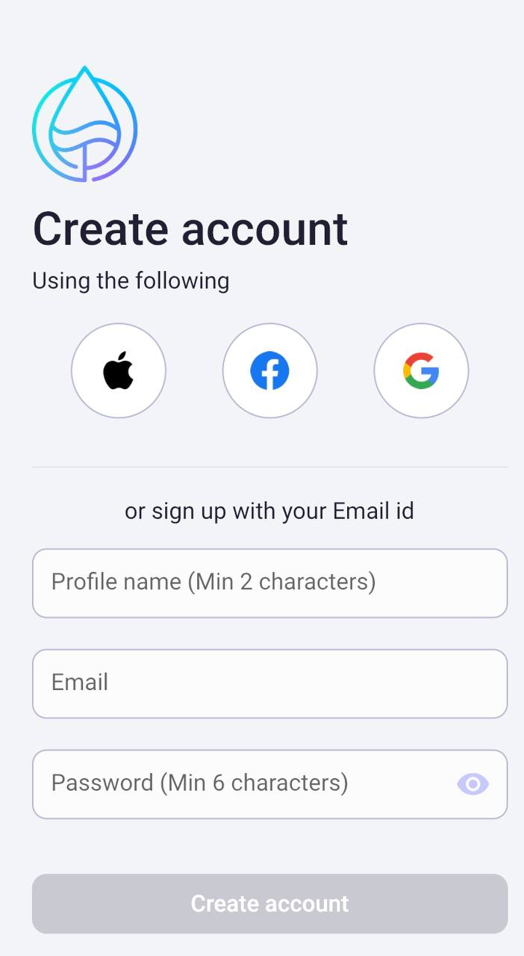
2. Create an account
Go through the tutorial
Click “Create Account”

Slide 4
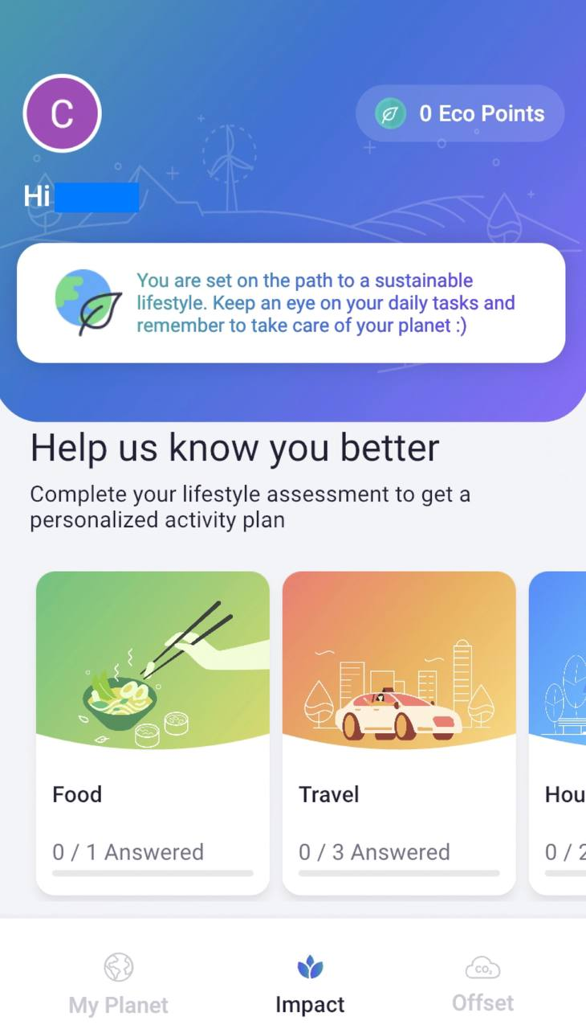
3. Complete Lifestyle Assessment
Go through the tutorial
Click on each quiz
Ensure that you have completed all 4 assessments
If you wish to edit or make changes to your assessment(s):
Click on “Profile”
Click on “My Lifestyle Assessment” to reattempt the lifestyle assessment(s)

Slide 5
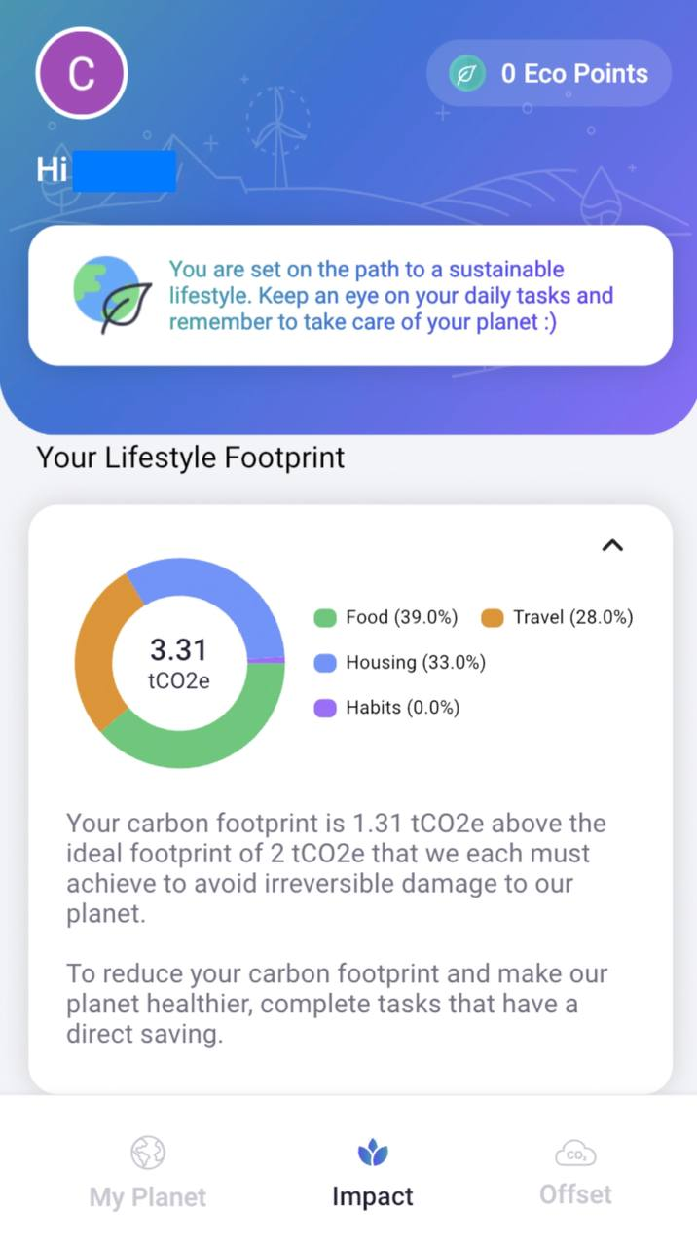
4. View your carbon footprint
Click on “Impact”

Slide 6
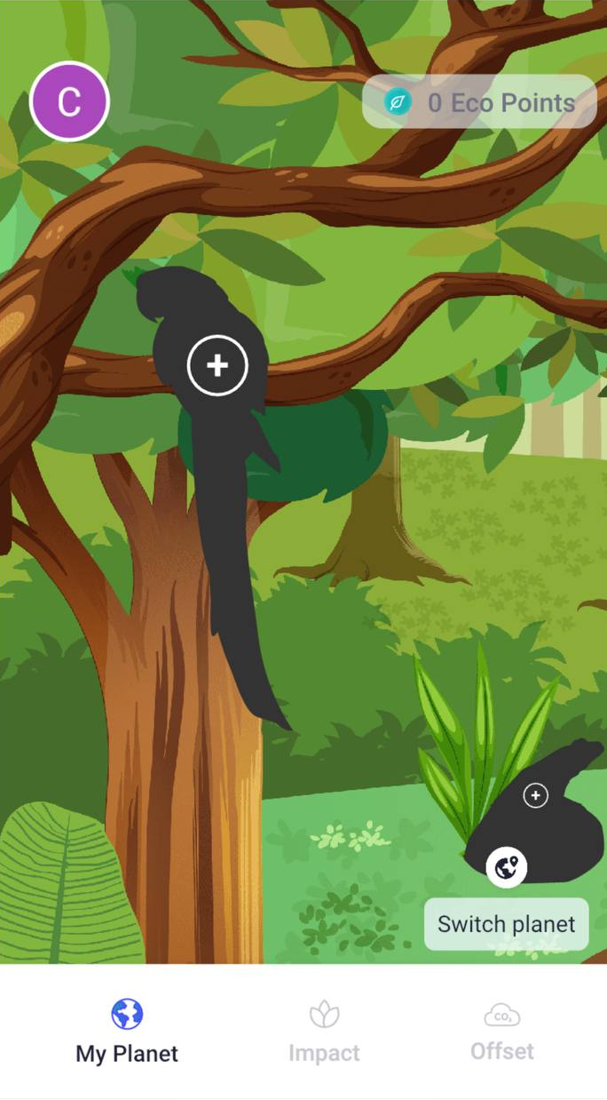
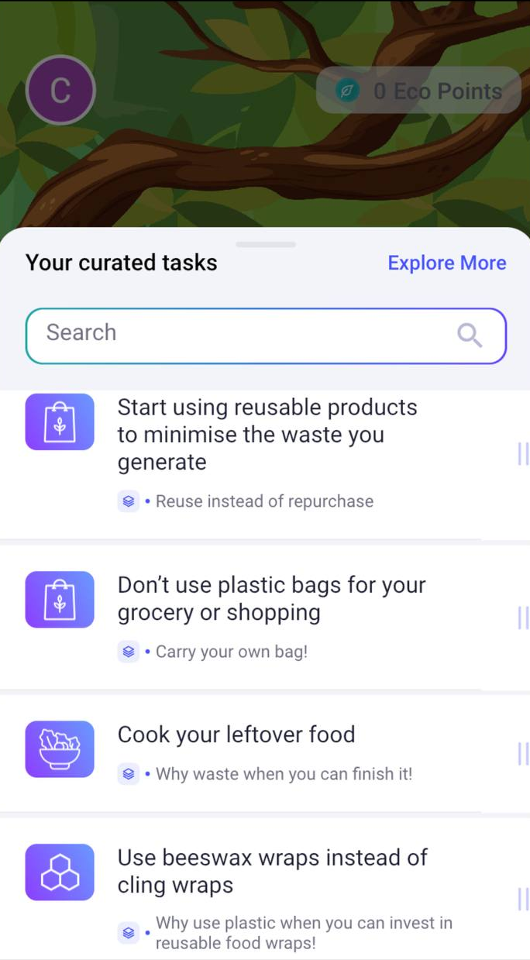
5. Accessing tasks
Click on “My Planet”
Click on any animal silhouette to browse through the curated tasks

Slide 7
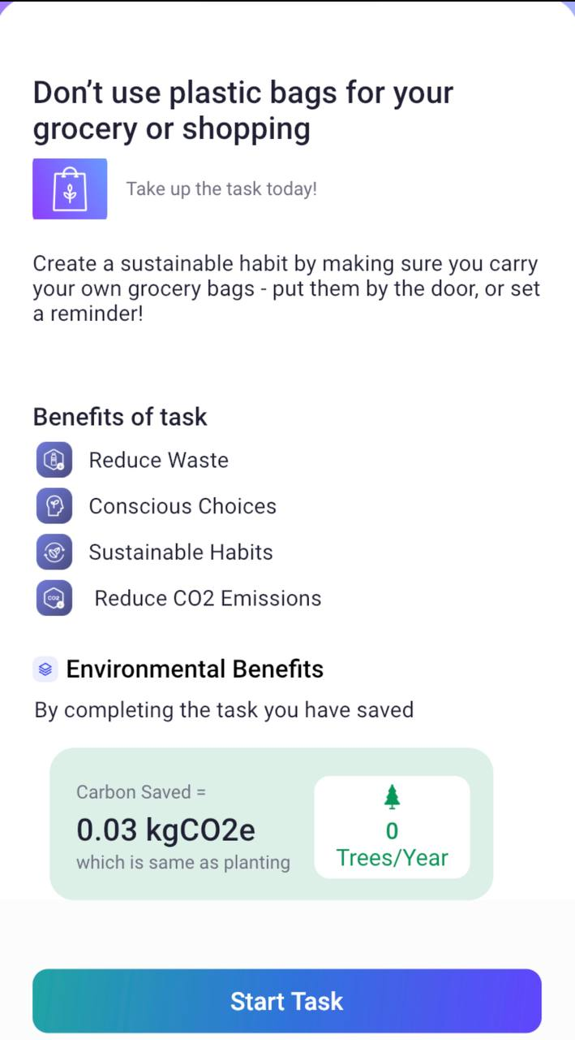
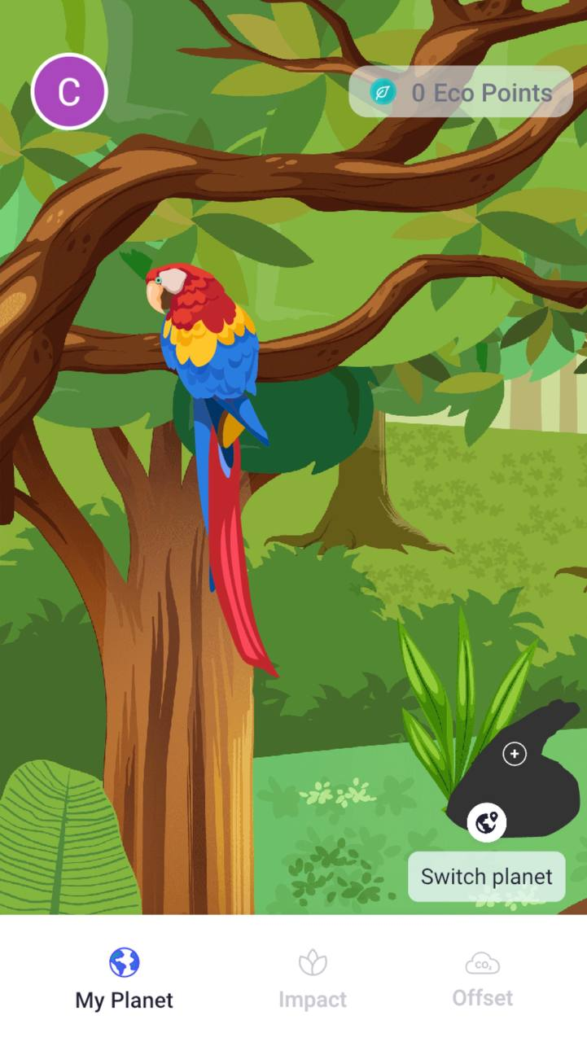
6. Selecting a task
Click on a task to view its potential environmental benefits
Click “Start task” to begin task
The silhouette will be filled up after the task is completed

Slide 8
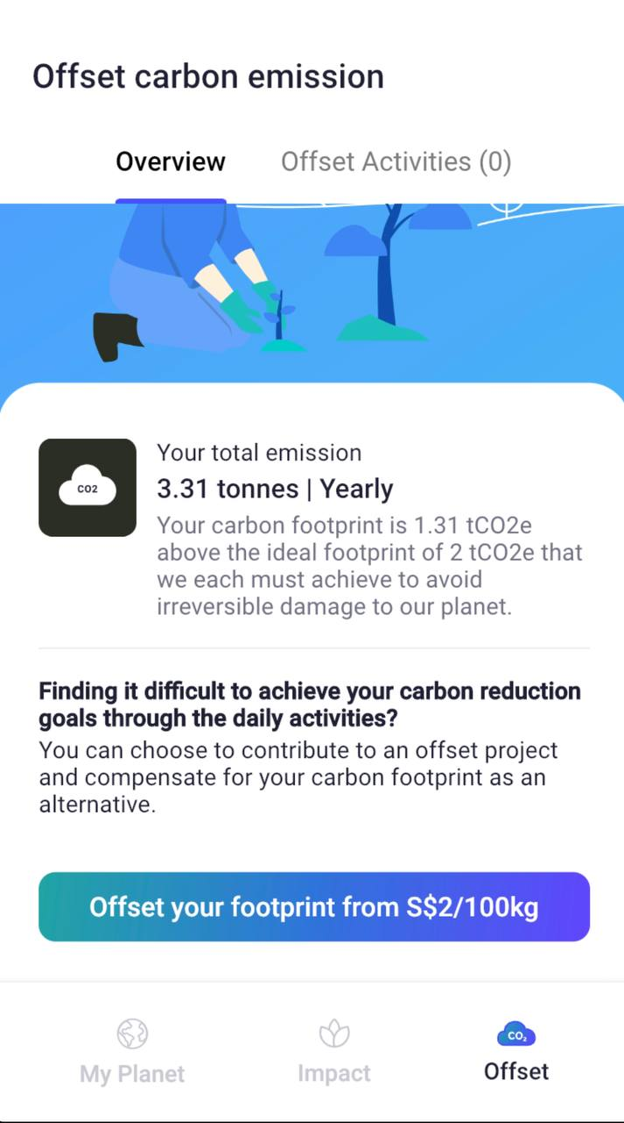
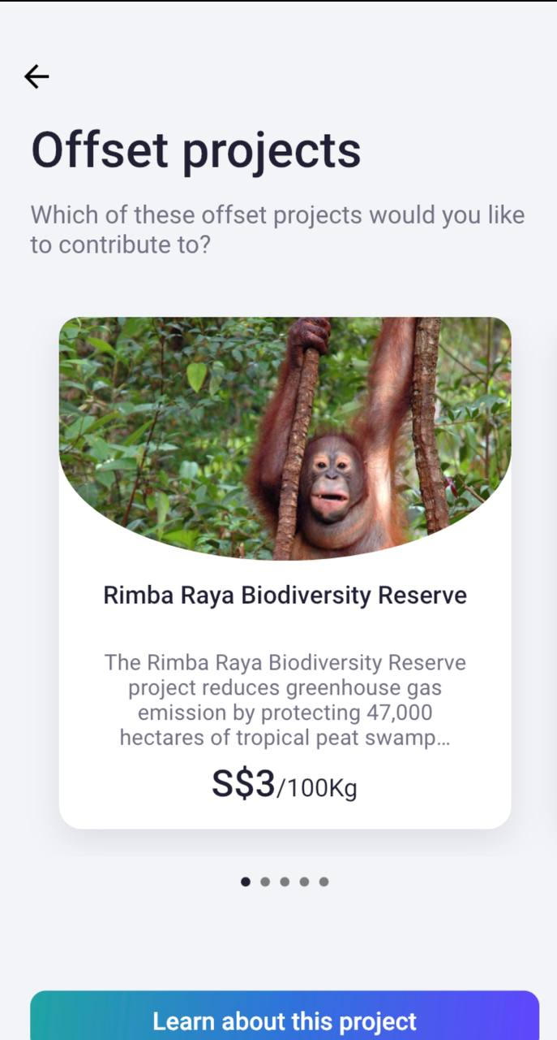
6. Browsing Offset projects
Click on “Offset”
Click “Learn about this Project” to know more about the project’s positive environmental impacts

Slide 9
Credits
Please retain this slide for credits
This curriculum resource was created by Colin Leong using screenshots from Adva

